Slide 1
Project Title
Product Review Management System

Slide 2
Motive & Need
Current Reviewing Platforms (Amazon, Flipkart) share 2 common flaws:
1. No detection for fake reviews for money.
2. No way of identifying trusted reviewers.

Slide 3
Requirements
Users:
Product sellers – people who provide products
Clients – people who review the products
Data Required:
Information of products that need to be reviewed
Previous reviews of products

Slide 4
Problem Statement
To develop a desktop application that will:
Allow clients to review products
View reviewed products
Allow sellers to advertise their products on a common platform

Slide 5
Hardware Requirements
4 GB RAM
500GB HDD
Intel core i5 (5th Gen) 64 bit processor
Devices such as Monitor, Mouse, keyboard etc.

Slide 6
Software Requirements
Latest 64bit Open Source (Linux) OS
Java Development Kit v1.8
Eclipse (Oxygen) IDE
Window Builder for Eclipse
Java JDBC (Type 4) Driver
MongoDB v4.0.1

Slide 7
Algorithms Used:
Searching for a product:
1. Get the text in the search bar using an action listener on search button
2. Pass the product object to the server using socket connection : output.writeObject(product)
3. Operation of the product: operation=‘search’
4. Receive the object : input.readObject()
5. if (object instanceof Product)

Slide 8
Algorithms Used:
5.1. Pass the object to funcProduct() method
5.2. Search for the documents using product name and tags in MongoDB using collection.find()
5.3 if (cursor.hasNext())
5.3.1 Form product objects of all documents
5.3.2 Add them in vector
5.3.3 Return the vector and write through socket.

Slide 9
Algorithms Used:
Adding review:
1. Create a review product in the submit button action listener.
2. Operation is: operation=‘addreview’.
3. Send the review object through the socket using output.writeObject(review)
4. if (object instanceof Review)
4.1 Send the object to the funcReview() method of JDBC class

Slide 10
Algorithms Used:
4.2 Form a Document with the appropriate attributes to be inserted in Review collection in MongoDB
4.3 Get the previous average rating of the product from the product collection
4.4 Find new average using the formula:
(avg*review_count*10+rating*level)/((rcnt+1)*10)
4.5 Update the average in the product collection
4.6 Get the level of the client and the total number of reviews they have given.

Slide 11
Algorithms Used:
4.7 Find the result of:
int r=(int)Math.round(1.5*Math.exp(level));
4.8 if (reviews_given>r and level<10)
4.8.1 level=level+1
4.8.2 Update level in the Client collection

Slide 12
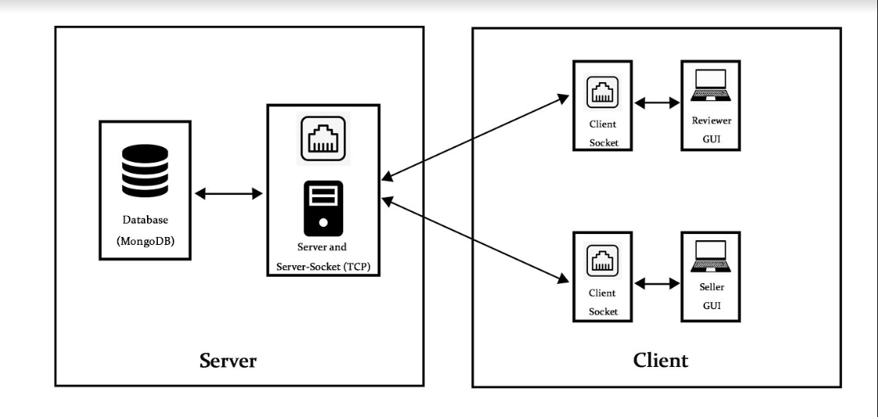
High Level Design

Slide 13
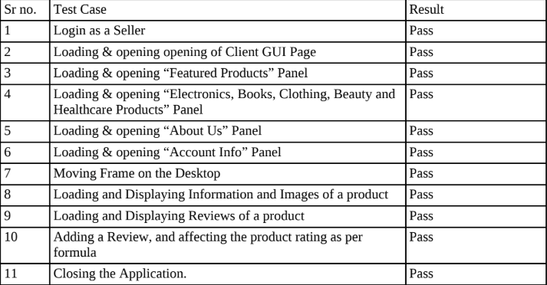
Testcases:

Slide 14
Result Analysis
Thus, we implemented a working and functioning model of the Product Review Management System, as per our requirements.
Backend Database:- Functioning Normally
Java Database Connectivity:- Functioning Normally
Client Server Architecture (TCP Sockets):- Functioning Normally
Graphical User Interface:- Functioning Normally
Logic and Algorithms Used:- Functioning Normally

Slide 15
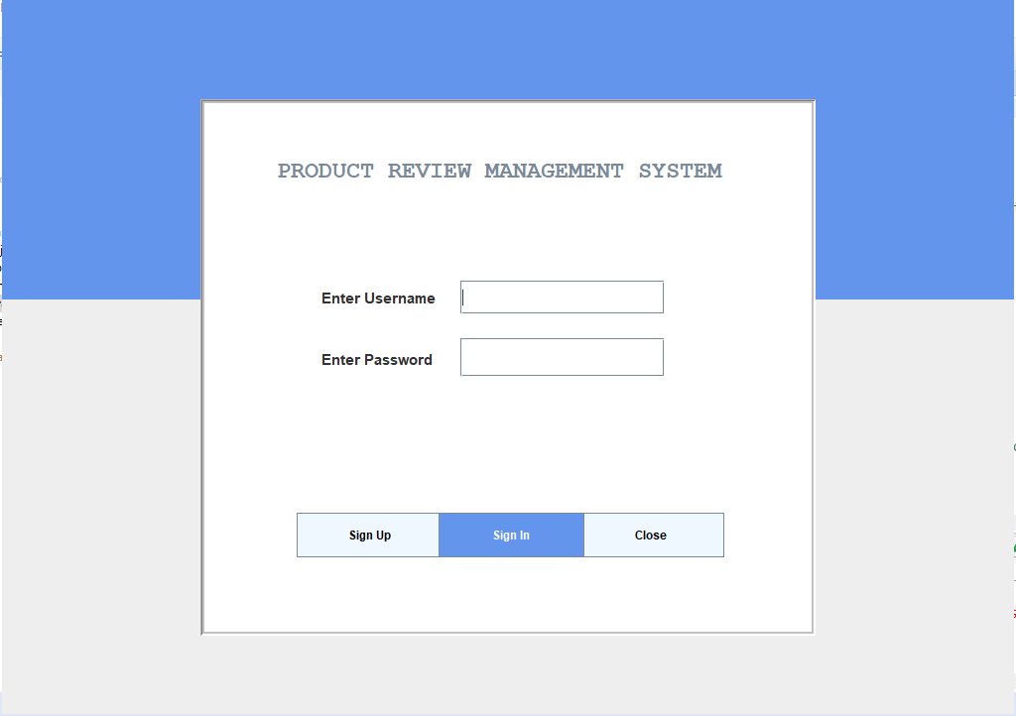
Screenshots

Slide 16
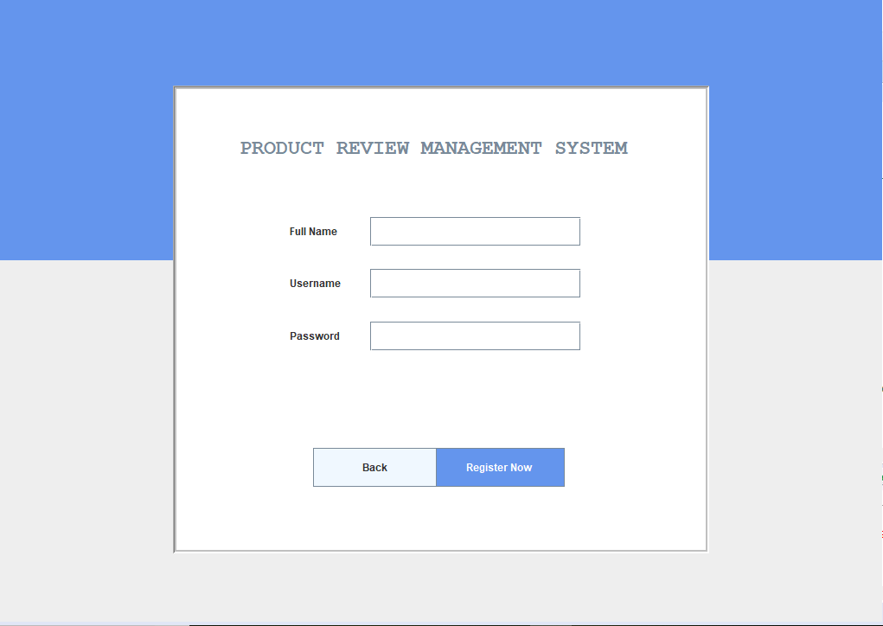

Slide 17
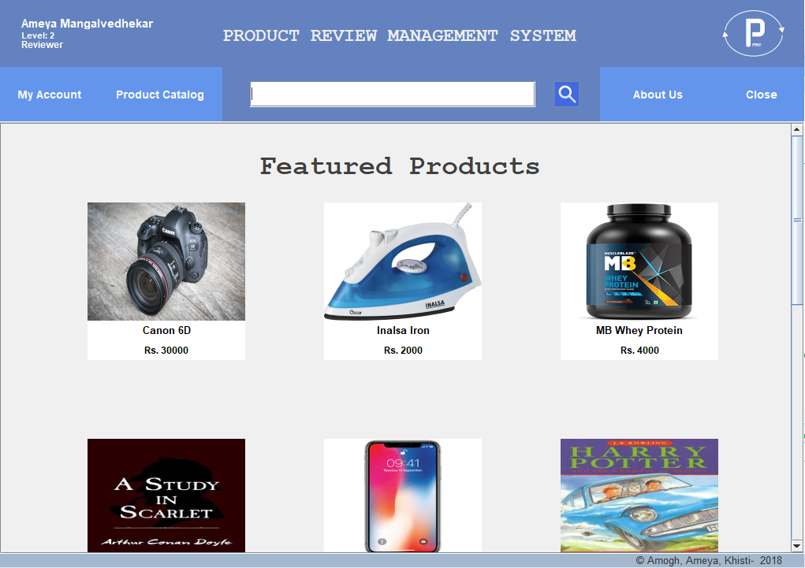

Slide 18
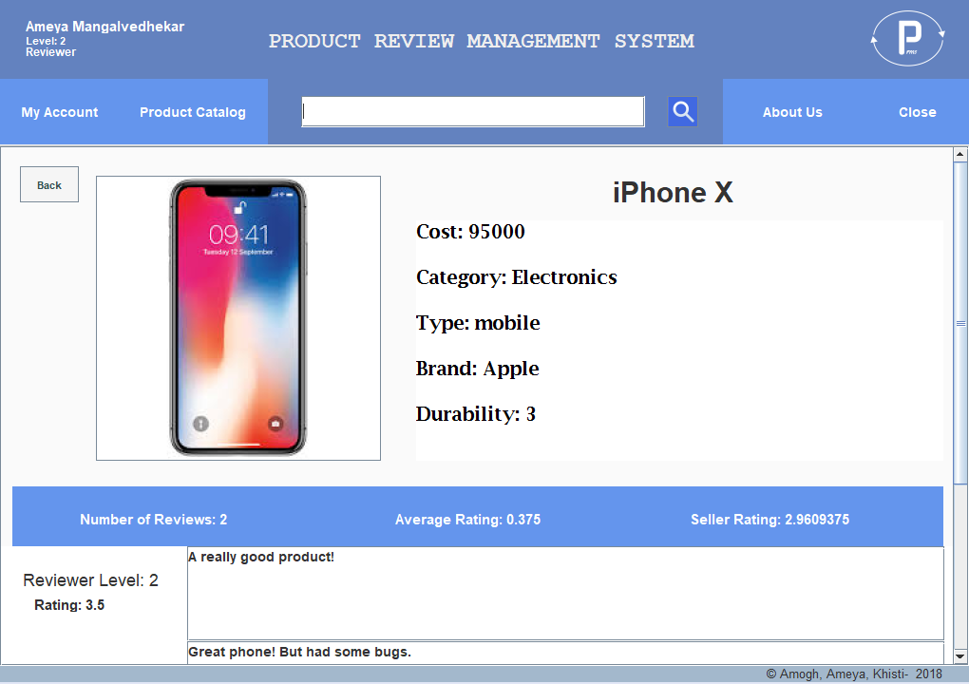

Slide 19
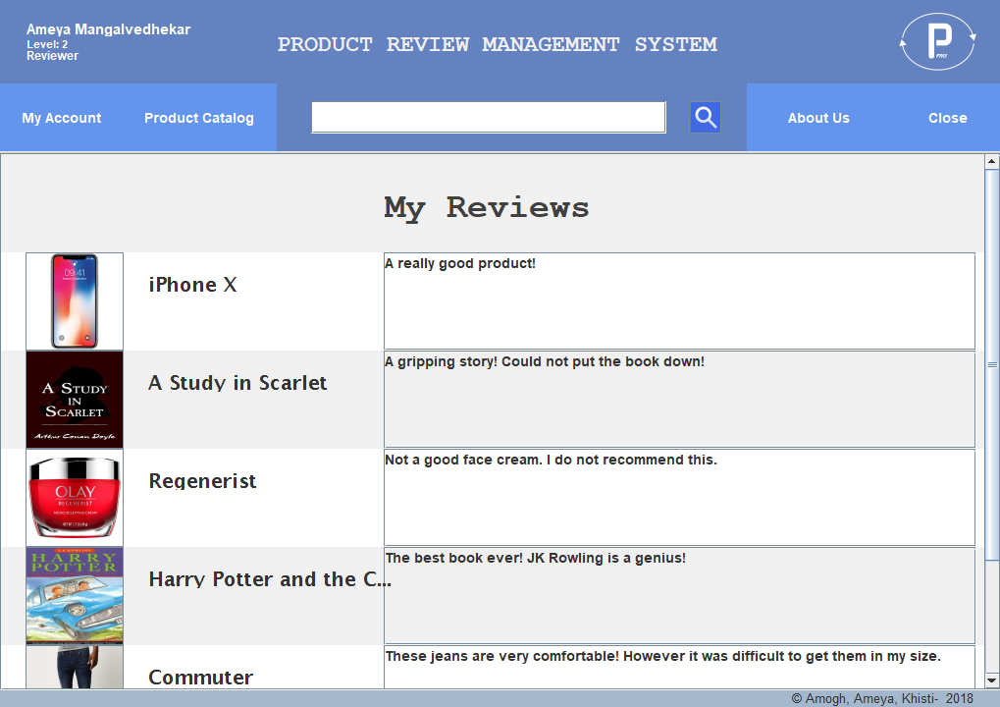

Slide 20
Conclusion
We have developed a desktop application using Java, JDBC and Swing for a Product Review Management System.
It incorporates the following features:
Abstraction between reviewer and seller
Allowing clients to choose quality products based on trustworthy reviews
Enabling them to review a product for future clients

Slide 21
Future Scope
Creating trusted micro and macro market review communities
Creating zero budget advertising platforms
Using natural language processing on reviews for sentiment analysis
Using machine learning to suggest clients to review products of their interest

Slide 22
References:
https://docs.oracle.com/javase/tutorial/
https://docs.mongodb.com/manual/
https://www.tutorialspoint.com/mongodb/mongodb_java.htm
Java: The Complete Reference, 10th Edition by Herbert Schildt

